Slide 1
Handwritten Digit Generator using GAN
Project using TensorFlow and MNIST Dataset
Notes:
Introduce the project title and your role. Highlight the use of TensorFlow and MNIST dataset. The visual should set a professional AI tone.

Slide 2
Project Objective and Dataset
Generate handwritten digit images using GAN
Learn adversarial learning principles
Train Generator and Discriminator together
Save generated images during training
MNIST Dataset: 60,000 training images
10,000 testing images
Image size: 28×28 grayscale
Digits 0–9
Notes:
Explain the goal of generating digits and the dataset used. Emphasize the scale and structure of MNIST for context.

Slide 3
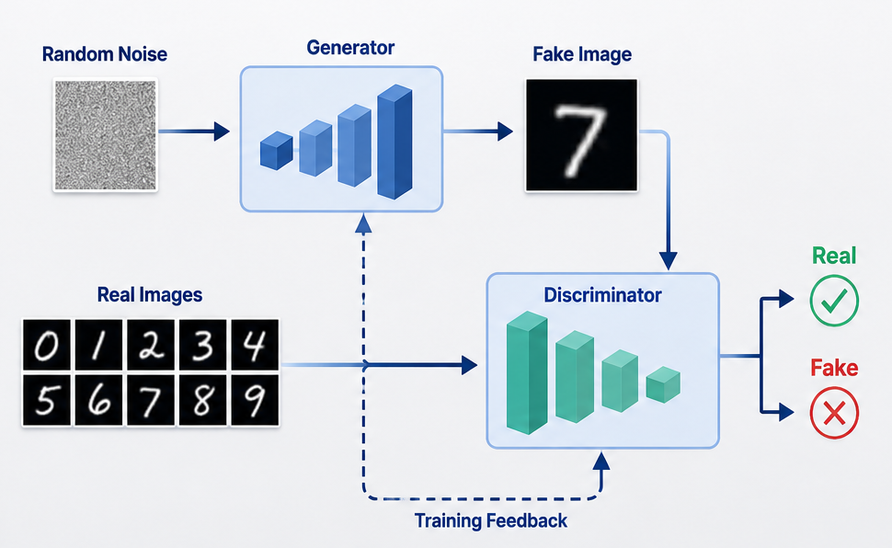
GAN Architecture
Generator: Creates fake digits from random noise
Discriminator: Classifies real vs. fake images
Goal: Generator fools Discriminator over time
Notes:
Describe the two-network system. Use the diagram to visually reinforce how the Generator and Discriminator interact during training.

Slide 4
Project Workflow
Load and preprocess MNIST dataset
Build Generator and Discriminator models
Train GAN with adversarial learning
Generate and save digit images per epoch
Compare outputs and save final models
Notes:
Walk through the step-by-step process. Highlight the iterative nature of training and evaluation in GANs.

Slide 5
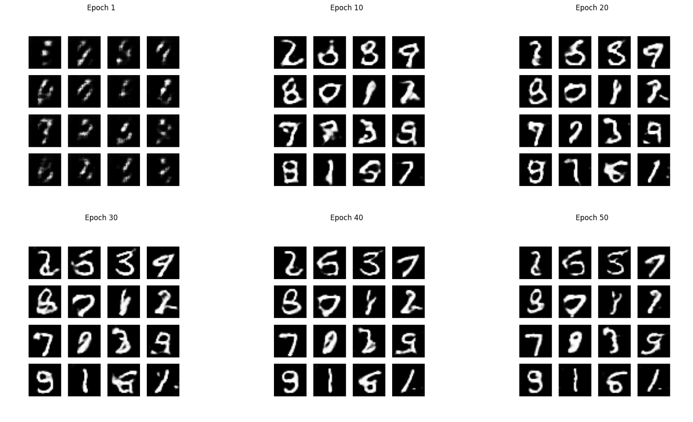
Training Results
Images clarified over 50 epochs
Saved Generator and Discriminator models
Successful realistic digit generation
Notes:
Show the progression of image quality. Emphasize how the GAN learned to generate more realistic digits with training.

Slide 6
Challenges and Conclusion
Challenges: Training instability, balancing networks, noisy early outputs, hyperparameter tuningConclusion: Implemented GAN, generated realistic digits, completed TensorFlow workflow
Notes:
Summarize key challenges like instability and tuning. Conclude with the project's success in generating digits and the skills learned.

